Slide 1
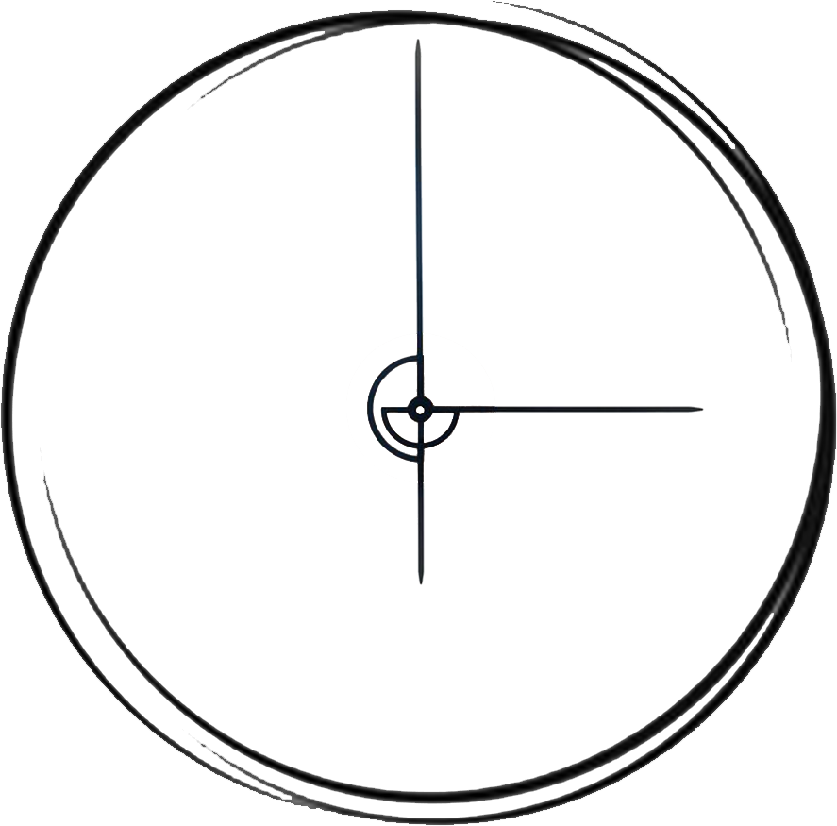
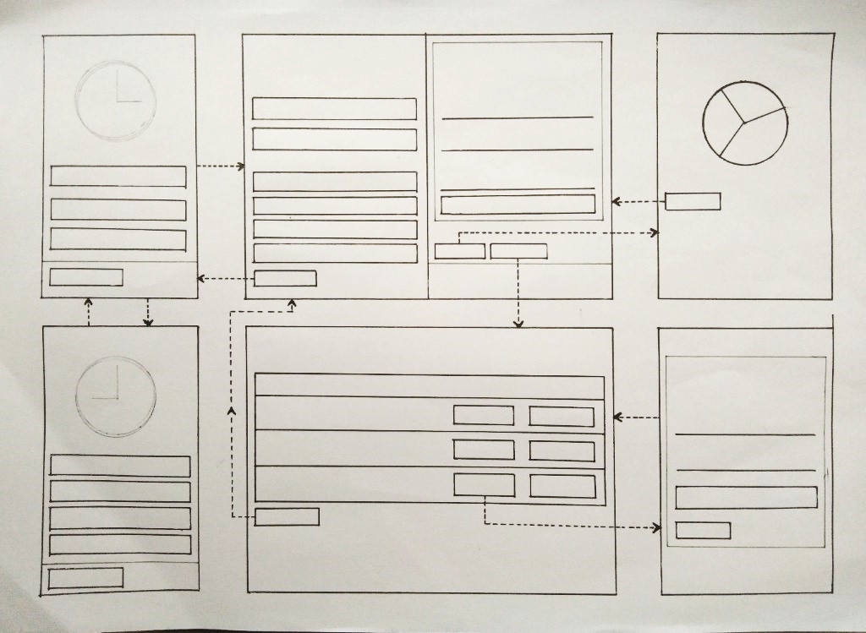
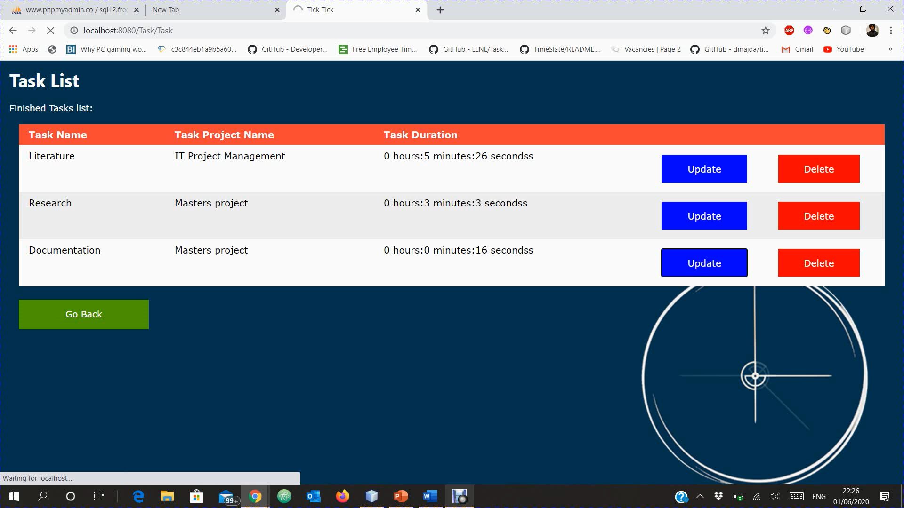
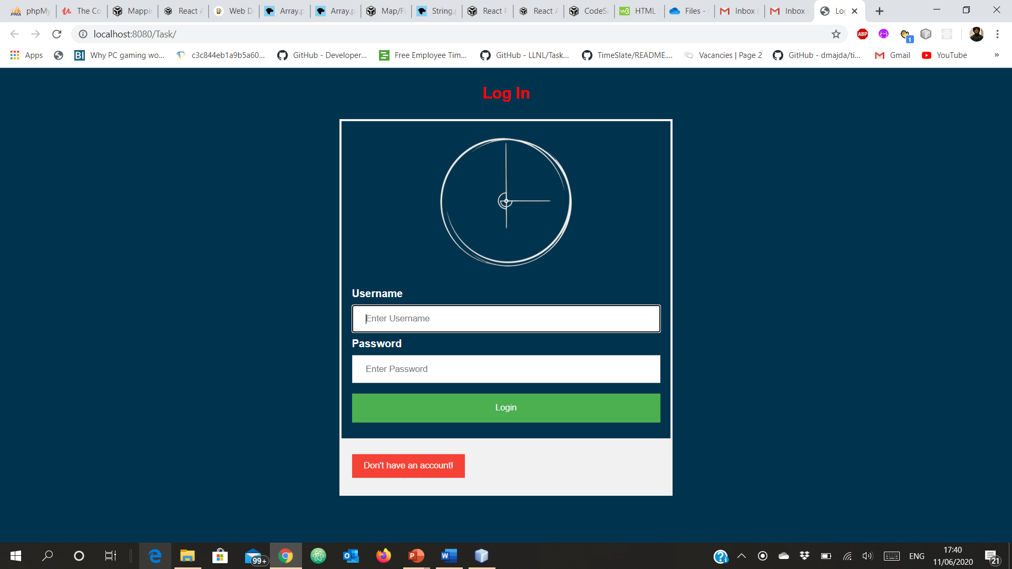
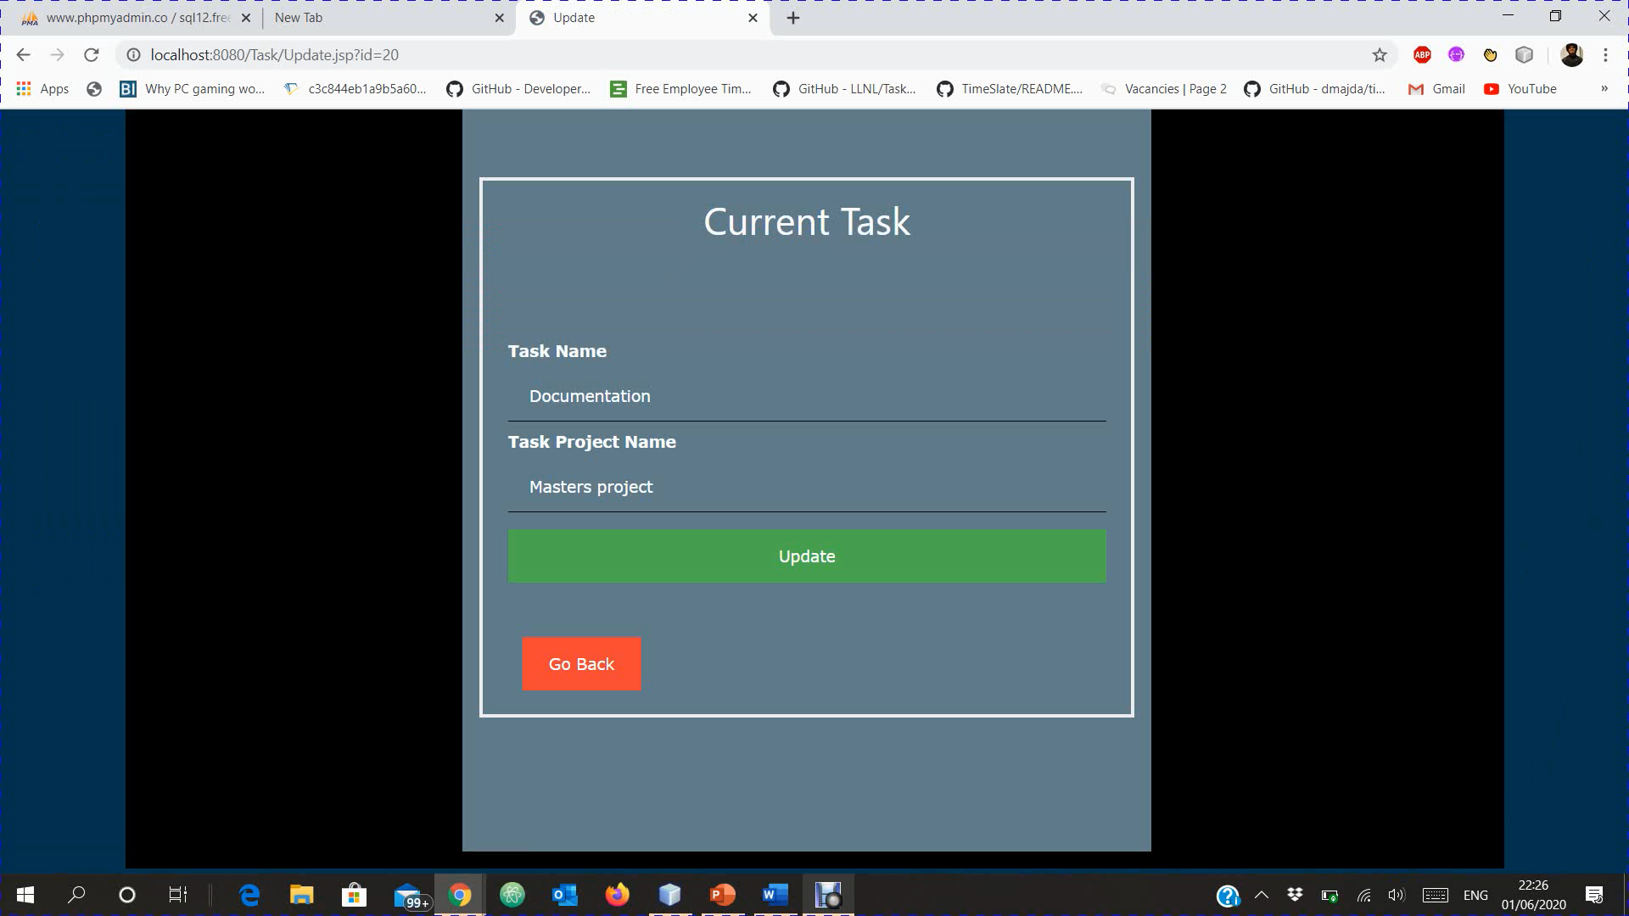
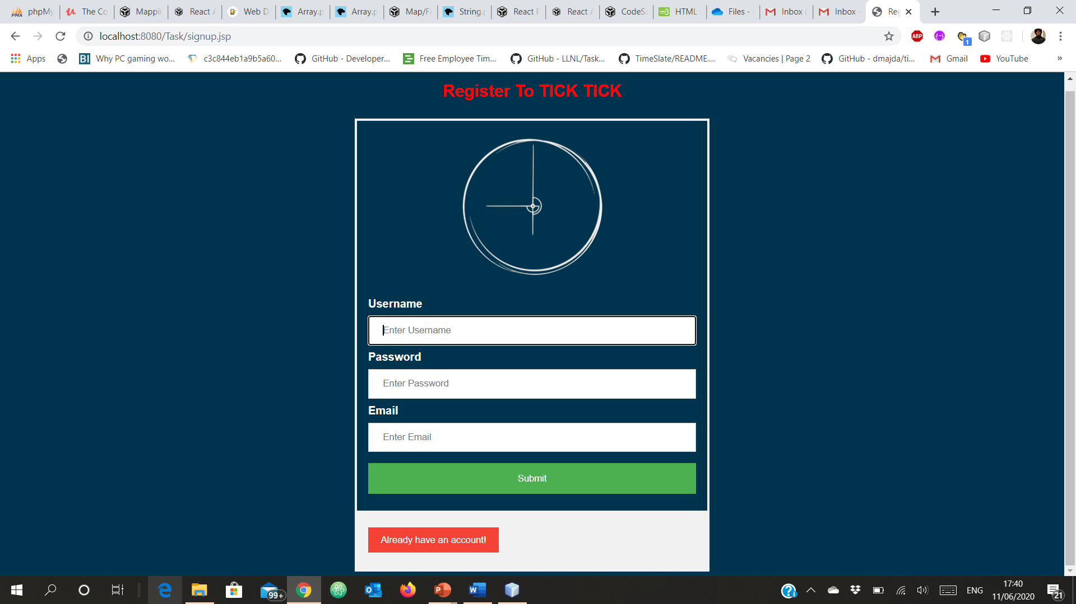
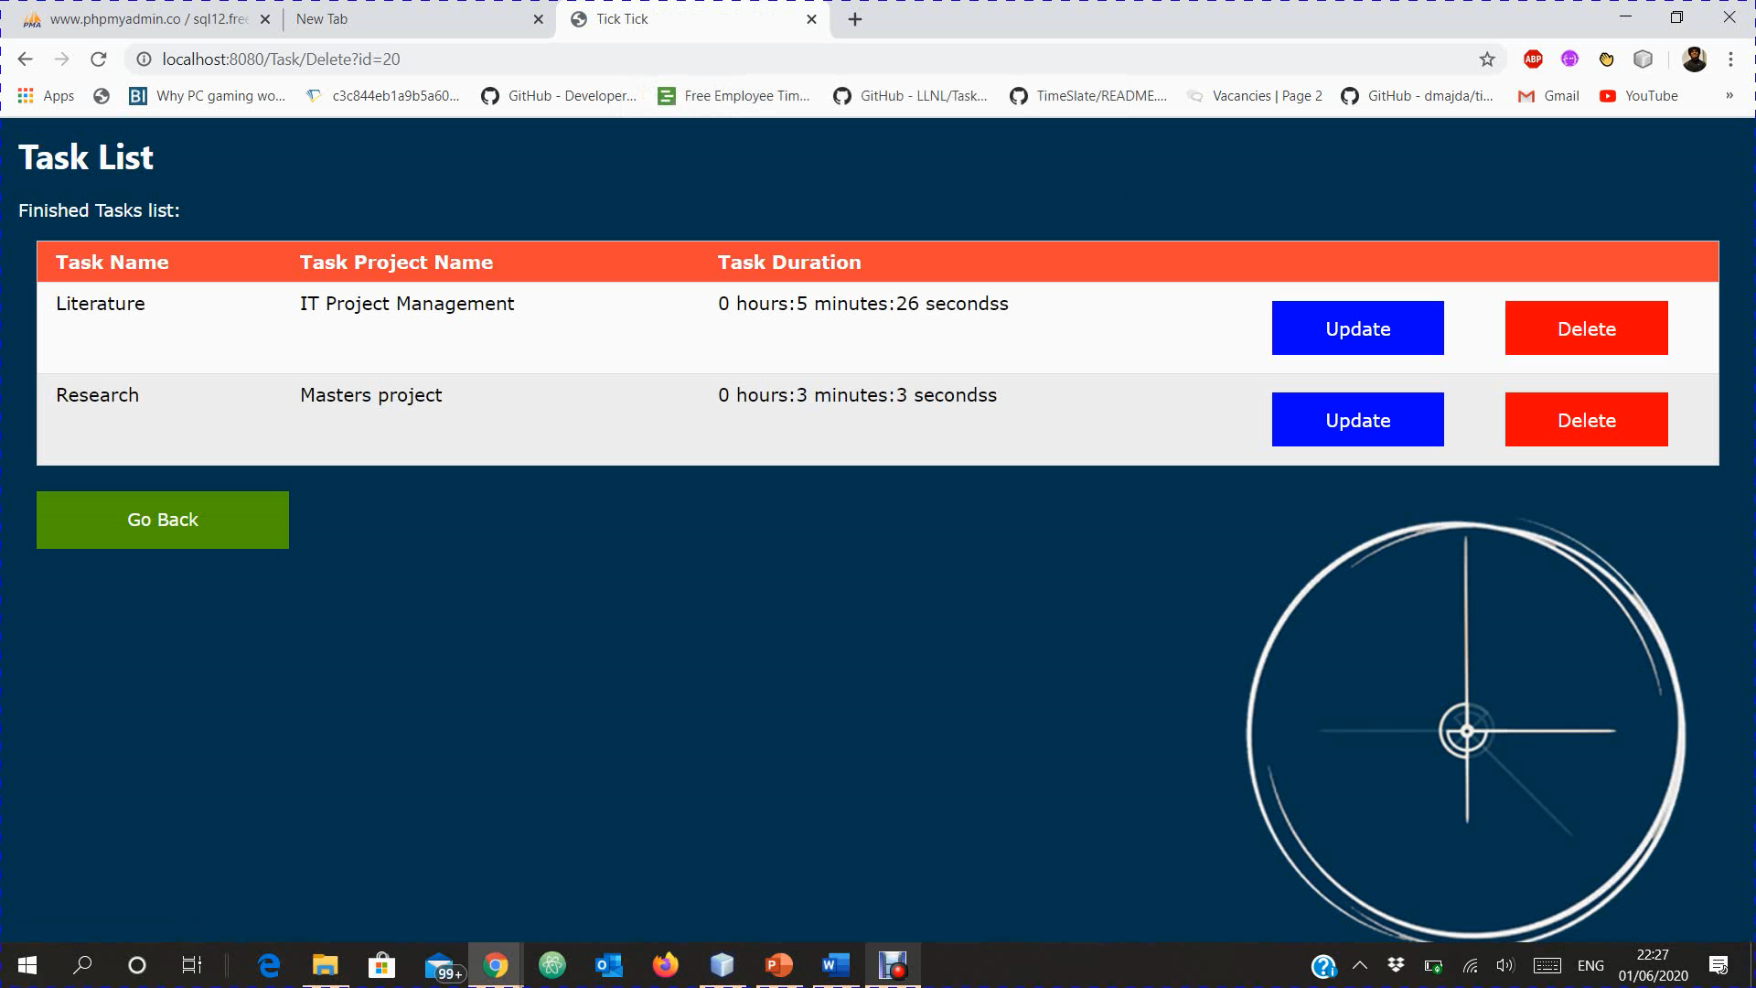
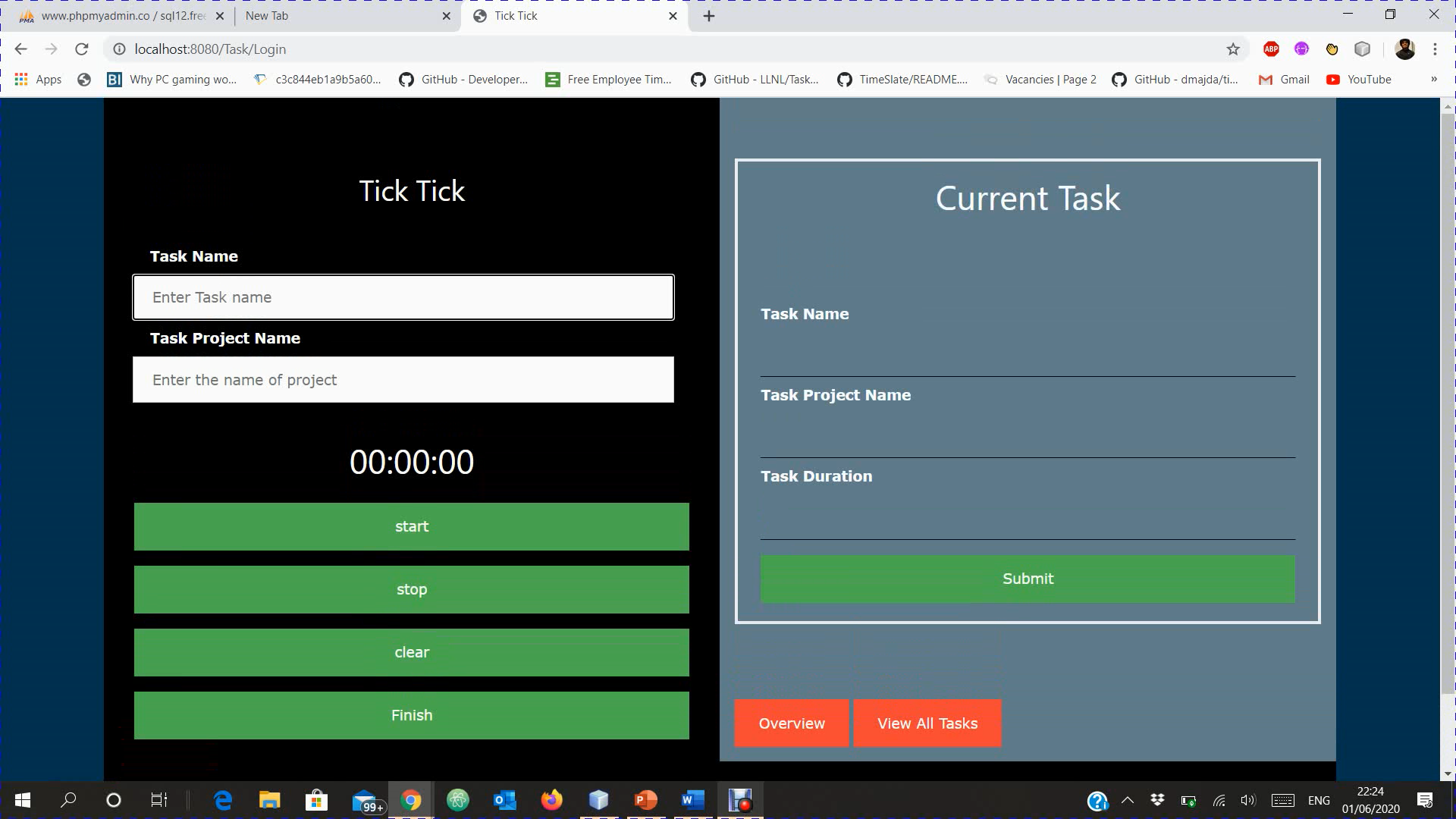
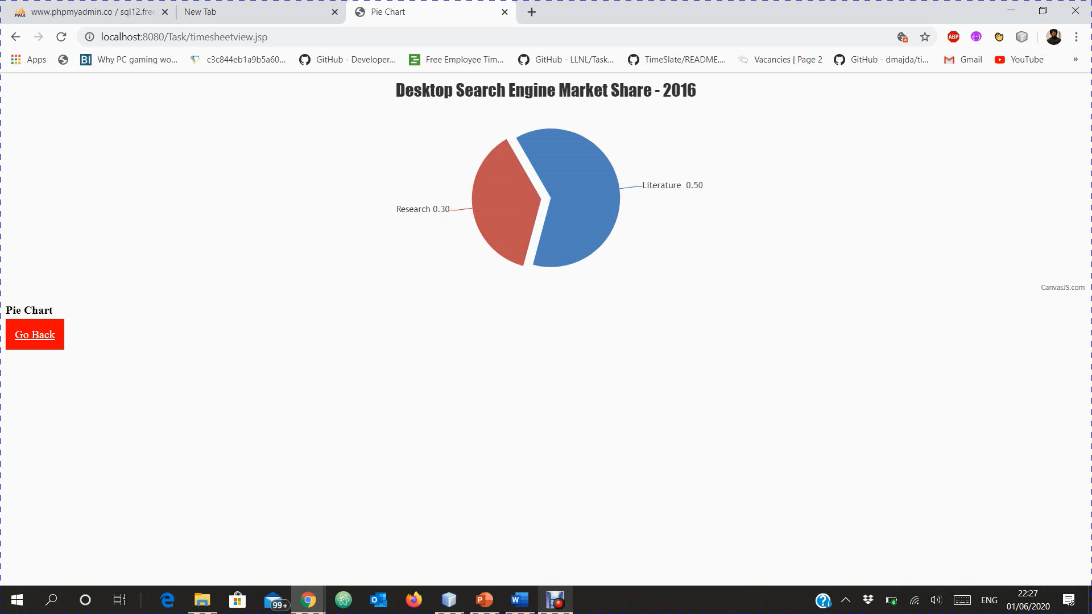
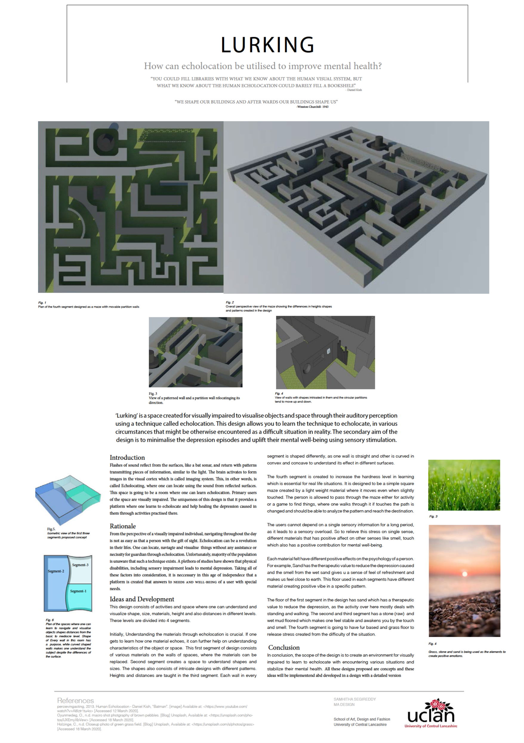
Tick Tick
A tool for Academic time tracking
Time is money
- (Benjamin Franklin)
Q) Who benefits?
Employer, management, administration.
Q) Who puts in the effort?
Developer
Q) How the software may change work?
It automatically records time spent on specific activity like academics, research etc. keeping this point in mind the employers will limit their intervals and wastage of working time which will eventually increase the productivity.
Q) Who are the clients?
Universities and colleges
Q) Who are the Users?
Employees, workers, Staff.
Q) Who others are affected directly or indirectly by the system?
Competitors, Staff – they might feel micro-managed and monitored when using this system.
Primary stakeholders – Ex: teaching staff.
Secondary stakeholders –Ex: management, employer, administration.
Tertiary stakeholders - Ex: University, Authority, Organisation, Competitors.
Facilitating Stakeholders - Ex: Developer(Me)
As the system user I want to keep track of my activities so that I can manage my time effectively.
As a system user I want to know where I have spent a lot of time on so that I can improve time management.
As an organization we want to keep track of the employees/ staff activity, to know how effective they are working.
As an organization, we want to notice the amount of time the staff was present/active, so that we can pay accordingly.
As a developer, I want to produce a better software, so that it will be benefited for everyone.
DESIGN BRIEF
STAKEHOLDERS | USER STORIES
The “Academic Time Tracking tool”, Tick Tick, is developed to allow its users to keep track of the time spent on their activities and also shows how productive they are. It is a simple timer which enables to record the total duration worked on a particular task. Focussing primarily on the development and implementation of the software, I used Jakob Nielsen’s heuristic approach as a study to understand how the user’s approaches can benefit the product’s usage.
Introduction
In this project, a simple time tracking software has been built to track the user's activity on a desktop. It is a timer-based time tracking technology where the software records the work performed. The activities performed by the user will be stored in the database for the analysis and future use. Fully understanding major patterns and seeing the work dynamics becomes easier by comparing similar details for present and past times. This method helps to automatically process data and get correct results in less time. The objective is to design and provide a comprehensive and effective time tracking system.
Rationale
Today, time is considered as one of employee's most important assets, and timekeeping is one of the most powerful methods for not just for measuring and justifying payable amounts but is also for evaluating efficiency and to maximize workflow. When we know which activities take the most of our time, we will start to think about whether the time spent is productive or not. To regulate that, one of the elementary and prevalent ways of understanding performance and calculating is to measure the time spent on work. To achieve this, the rationale of ‘Academic Time Tracking’ evolved.
Development
The software developed for the project has started by gathering requirements to depict a procedure to define the set guidelines, deadline, scope, boundaries of work and a schedule for the entire phase of the project. A list of requirements are agreed mutually between me and the supervisor. Once the adequate requirements are gathered, the initial development of the software has begun using Agile techniques. Firstly, the literature has been studied related to the project and relevant matter useful for the project is obtained. Then a list of stakeholders, user stories, design brief and advantages & dis-advantages for the potential users has been developed. Later the design is produced using techniques like mind mapping, storyboarding and wireframes to show how the product is going to be and who are the potential users with a simple persona.
Moving forward, a login and registration page was setup using HTML5 and CSS3 on Atom text editor. The work done has no backend links which means that it is only plane html and css leading the user to nowhere. It is done to show how the website opening looks like and how the registration and login process would be. Later by using JavaScript the links were created to allow the user to land on the desired page, making sure the links are proper with no errors. An external UI framework called Bootstrap has been used to build web pages for a simple and tidy look. The predesigned templates also helped to build the front end easier and quicker. Then the code to run the timer and track the activity of the user has been written using the JSP servlets to insert Java code into html pages, JDBC to handle the connection to the database, Java as the programming language and MySQL as the database to store and record data. The NetBeans glassfish server is used as a web server i.e., for handling HTTP requests
from browsers. This is achieved with the help of some online lectures, previous modules, trusted and recognized websites and some previous work done by various developers on GitHub. The timer interface has been updated and modified according to the user requirements as we progressed further. On the later stage, the supervisor requested to show the user activity and tasks performed using a pie chart. So that, the user can get the overview of their performance.
After landing on the webpage, the user would be able to view the login page. Using the login details, the user can login and start using the application. If they haven’t registered before, then they need to go on to the registration page by clicking on the “don’t have an account” button located at the bottom left of the login page. Once they click on that, it will be redirected to the registration page, where they can register themselves by providing the username, email address and a password that they can remember. After registration, an alert message pops on the screen saying, “successfully registered” and then will be redirected back to the login page. Now using those details, they have registered with, they will be able to login. Providing wrong log in details will end up with an alert message saying ‘sorry! Invalid username or password’.
After successful login they will be receiving another alert message displaying Welcome and the user’s username provided. By clicking on the ‘OK’ button, the provided details will be registered in the database under the table name register. Then they can proceed to the timer page where they can run the timer after mentioning the Task name and Task project name. After mentioning, they need to click on the start button for the timer to start recording and can click on the stop button to stop the timer. The clear button is to clear in case any errors made. The finish button is to save the recorded details and display in the user task layout. The submit button at the bottom of user current task will allow the data recorded to be stored on to the database under the table name task. Taking the users time spent on the different tasks, a pie chart is generated. This chart shows the percentage of time, the user has spent on their tasks. It is to get a better understanding where he is spending more time and will give a little overview of their performance. The ‘view all tasks’ button will let us land on ‘Your Task List’ page where we will be able to see all the tasks performed. Here we can update or delete our finished tasks if wanted to. The ‘Go Back’ button will redirect back the timer page and allow the user to continue using the software. The logout button at the bottom left corner will logout the user and will be redirected to the login page. This is how the software functions and is developed keeping in mind the potential users and making sure its user friendly.
Conclusion
To conclude, time tracking tool helps to automate the work cycle, get rid of time-consuming manual tasks and make the simple tasks procedures easier and more visible for the users. The key to deriving the most benefit from its performance is to properly coordinate the operation. Its objective is to provide a general image of the usage on the computer. Collecting and reviewing employee activity data regularly will help shed surprising light on certain deep-seated problems or reveal negative patterns or challenges in the workflow and eventually show that what areas the organisation/ employer need improvement.
Fig.1. A wireframe showing the skeletal framework of the project
Fig.5. The finished task list page which allows the user to update or delete completed tasks
Fig.2. The Login page which allows the user to login
Fig.6. The update task page which lets the user to update the name of the task or project
Fig.3. The Registration page which lets user to register
Fig.7. The finished tasks list after deleting one of the task.
Fig.8. A pie chart showing the overview of the tasks completed.
Fig.4. The timer page where the user can perform the task.
References
Actitime.com. (2020). Time-Tracking: The Complete Guide. [online] Available at: https://www.actitime.com/time-tracking/time-tracking-software-essay [Accessed 6 May. 2020].
Britton, B.K. and Tesser, A. (1991), “Effects of time-management practices on college grades”, Journal of Educational Psychology, Vol. 83, pp. 405-10.
Farmer, S. and Seers, A. (2004), “Time enough to work: employee motivation and entrainment in the workplace”, Time & Society, Vol. 13, pp. 265-84.
Gallup, I., 2007. U.S. Workers Say They Waste About An Hour At Work Each Day. [online] Gallup.com. Available at: https://news.gallup.com/poll/28618/us-workers-say-they-waste-about-hour-work-each-day.aspx [Accessed 3 May 2020].
Martin, R.C., 2002. Agile software development: principles, patterns, and practices. Prentice Hall.
HARISH VARMA VATCHAVAI
MSc COMPUTING
School of Physical Sciences and Computing
University of Central Lancashire

